Slide 1

Lesson 4.01: Looping Basics
Microsoft Philanthropies TEALS Program
Introduction to Computer Science
Semester 2

Slide 2
Looping Basics
After this lesson, you will be able to...
Define and identify for loop, item, iteration, scope
Loop through (traverse) the items in a list
Introduce and compare for and while loops in Python

Slide 3
Today’s Plan
Day 1
Do Now
Lesson
Lab
Debrief
Notes:
10 Minutes Do Now
10 Minutes Lesson
30 Minutes Lab
5 Minutes Debrief

Slide 4
Do Now, Part 1
In your console, enter the code at the right.
In your notebook,
Write down what happened.
What would happen if you added 100 items to the list single_fruit?
Write down how you would update multi_fruit, following this template code.
single_fruit = ['apple', 'banana', 'watermelon', 'grape']
multi_fruit = []
multi_fruit.append(single_fruit[0] + 's')
multi_fruit.append(single_fruit[1] + 's')
multi_fruit.append(single_fruit[2] + 's')
multi_fruit.append(single_fruit[3] + 's')
print(multi_fruit)
Notes:
single_fruit = ['apple', 'banana', 'watermelon', 'grape']
multi_fruit = []
multi_fruit.append(single_fruit[0] + 's')
multi_fruit.append(single_fruit[1] + 's')
multi_fruit.append(single_fruit[2] + 's')
multi_fruit.append(single_fruit[3] + 's')
print(multi_fruit)

Slide 5
Do Now, Part 2
Enter the code to the right into your console.
list_of_numbers = [3, 5, 10, 23]
for num in list_of_numbers:
print('num is ' + str(num))
In your notebook,
Write down what happened.
How would this change if you added 100 items to list_of_numbers?
Rewrite the code from part 1 using what you learned from this example.

Slide 6
Do Now, Part 3
Rewrite the code from part 1 using what you learned from Part 2.

Slide 7
Lesson
Discussion: Look at Part 1 of the Do Now. What would happen if the list got much larger?
Discussion: Look at part 2 of the Do Now. What would happen if the list got much larger?
Notes:
If they say they would write down a lot of code, ask how readable that might be, or how long would it take to write, or the greater potential for bugs due to typos.
Go over part 2 of the Do Now. Ask the students what happened. Ask if they remember something similar from Snap!
Introduce the for loop as a way to deal with issues associated with part 1 of the Do Now.

Slide 8
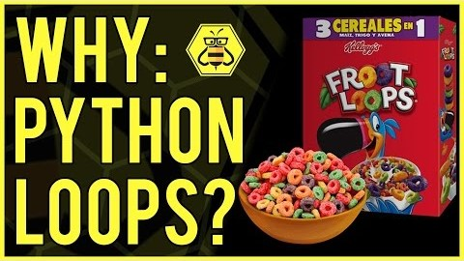
Loops
Notes:
For Loop Explanation
The first 4 minutes and 15 seconds explain four loops https://youtu.be/KosrKNJK9Sw

Slide 9
Loop – Definition and Iteration
A loop is a sequence of instructions that is continually repeated until a certain condition is reached.
Each repetition is called an iteration.
Examples
Search a list of students for the ones with names beginning with ‘R’
Find all the prime numbers from 1 to 100
Repeatedly execute user commands until a game is over

Slide 10
Loops - for Loop
list_of_numbers = [3, 5, 10, 23]
for num in list_of_numbers:
print("num is " + str(num))
For
Loop
Condition
Body
Iteration | Variable | Value
1st | num | 3
2nd | num | 5
3rd | num | 10
4th | num | 23
Notes:
As we'll see in Unit 4.02, the "in" syntax is also used in Python for the common task of iterating through a series of equally-spaced numbers: for num in range(100): # counts from 0 to 99
or
for num in range(10,51,5): # num takes values 10, 15, 20, 25, 30, 35, 40, 45, 50

Slide 11
Loops - while Loop
Condition
while playing == True:
action = input("Choose an action, {0} -->".format(player_name))
if action == "travel" or action == "t":
handle_travel()
elif action == "rest" or action == "r":
handle_rest()
elif action == "hunt" or action == "h":
handle_hunt()
The player inputs a command for each iteration.
While
Loop
Body

Slide 12
Loops - Loop over Characters in a string
a_string = "text"
for char in a_string:
print("char is " + char)
Iteration | Variable | Value
1st | char | “t”
2nd | char | “e”
3rd | char | “x”
4th | char | “t”

Slide 13
Lab – De Vowel
Create a de_vowel function.
Input is a string
Output is a copy of the string
The copy should have the vowels removed
'a', 'e', 'i', 'o', and 'u' are counted as vowels, but not 'y'.
Create the function contract for de_vowel.
Write de_vowel using a for loop
Provide a few examples that confirm de_vowel works as expected:
What if the string is all vowels?
What if there are no vowels?
What if there is a mix of vowels and non-vowels and spaces?
What if some of the vowel characters are capitalized?

Slide 14
Starter Code
# contract goes here
def de_vowel(a_string):
# your code goes here
no_vowels = de_vowel("This sentence has no vowels")
print(no_vowels)
# examples go here

Slide 15
Bonus
Use a counter (variable you define outside of a loop to keep track of a value inside a loop) to create a function count_vowels.
count_vowels takes in a string and returns an int representing the number of vowels in the string.

Slide 16
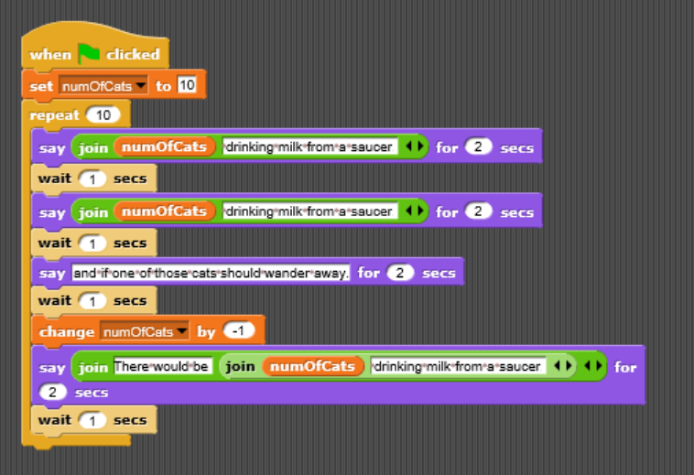
Snap! Challenge
Create the following program in Python.

Slide 17
Exit Ticket/Reflection
In your notebook,
Write down an example of how you could use a for loop in a computer program.

